Slide 1
IMDB DataSet Analysis
Presented By: Deepthi V
EJ H
Hritik S
Sandhya B

Slide 2
What is your favourite movie?

Slide 3
Objectives
To analyse the perception of different movies across genres by analysing their rating, metascore, gross amount etc.
To identify top actors and top directors loved by audience.
To find insightful informations using data visualization.

Slide 4
Understanding The Dataset
IMDB Movies dataset : https://www.kaggle.com/datasets/harshitshankhdhar/imdb-dataset-of-top-1000-movies-and-tv-shows
Shape of dataset 1000x16
Total 16 columns
Average runtime is 122 min
202 unique genres

Slide 5
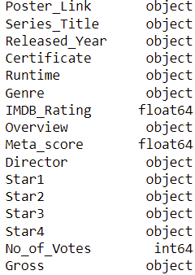
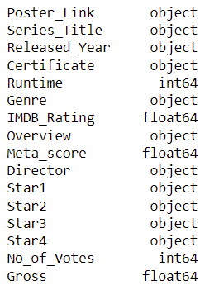
Column names along with there data types before and after cleaning are shown

Slide 6
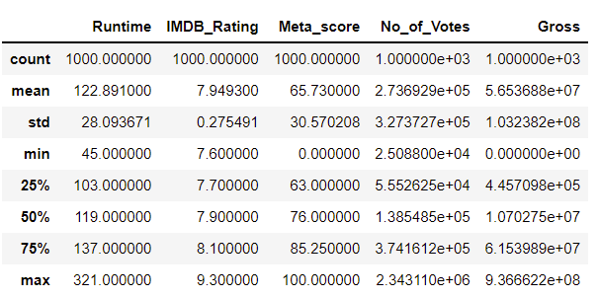

Slide 7
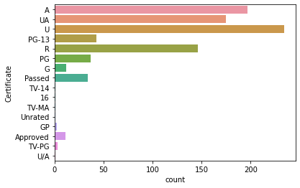
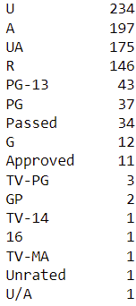

Slide 8
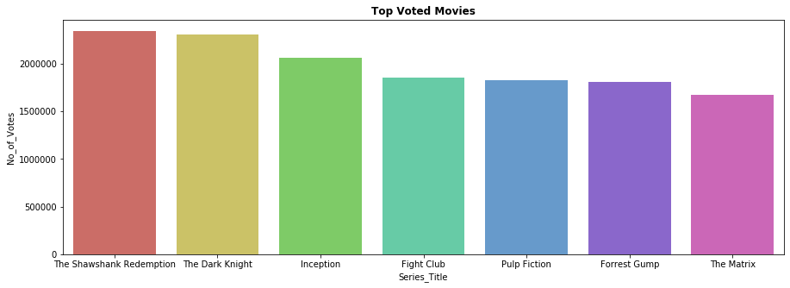
Top Voted Movies

Slide 9
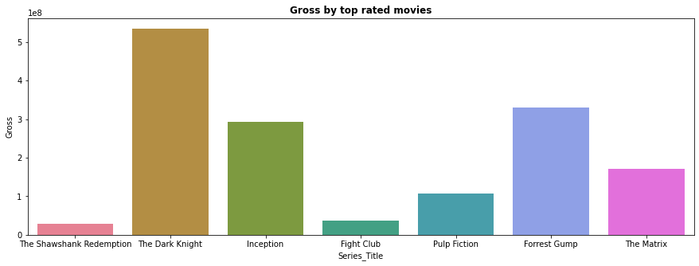
Gross by top rated Movies

Slide 10
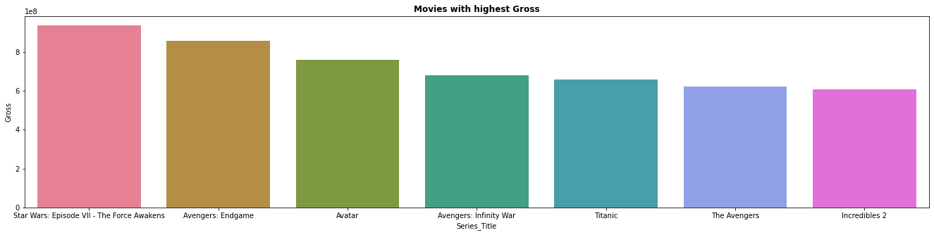
Movies with highest Gross

Slide 11
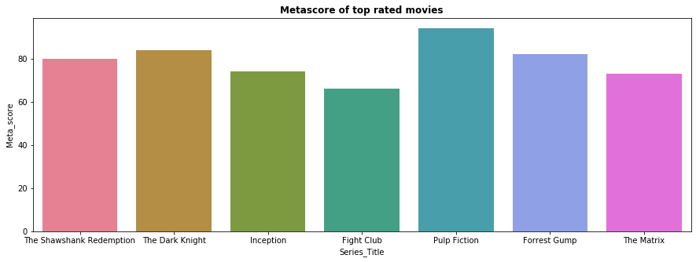
MetaScore of Top Rated Movies

Slide 12
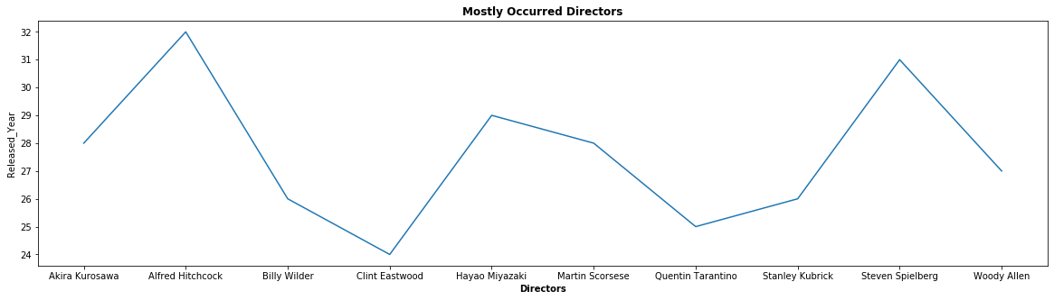
Release Year of Mostly Occurred Directors

Slide 13
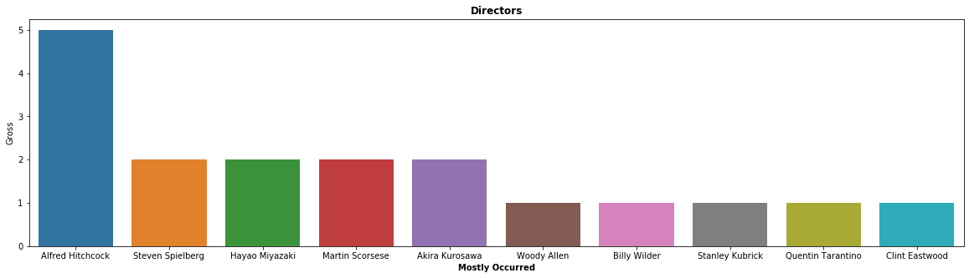
Mostly Occurred Directors and Gross Amount Collected

Slide 14
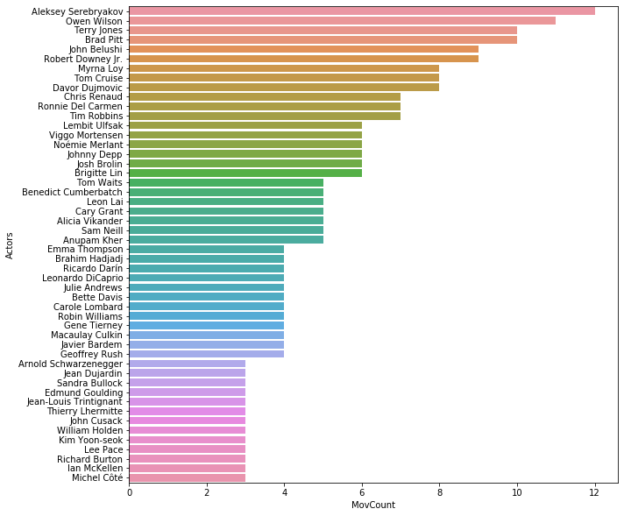
Actors and Their Movie Counts

Slide 15
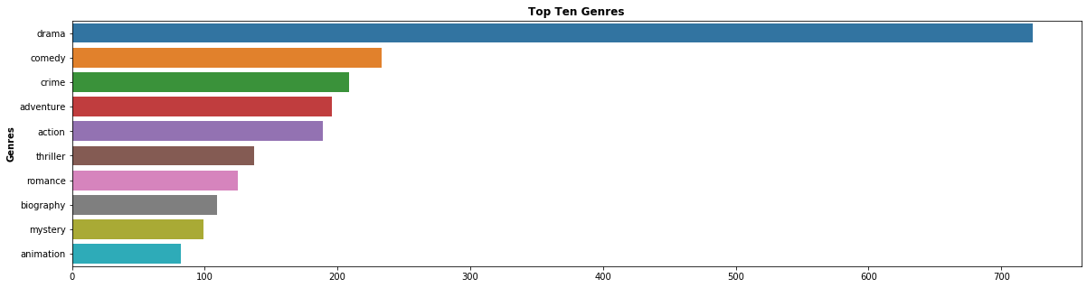
Top 10 Genres

Slide 16
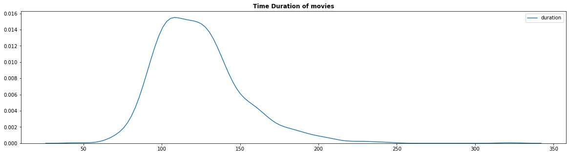
Time Duration of Movies

Slide 17
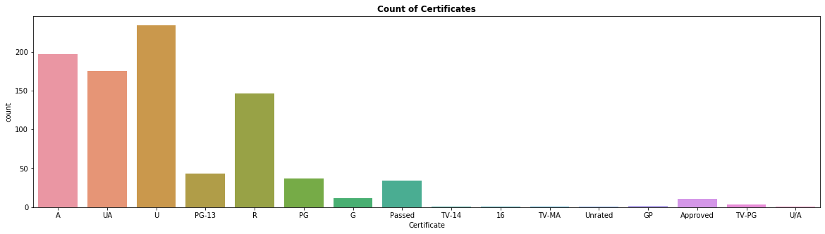
Count Of Certificates

Slide 18
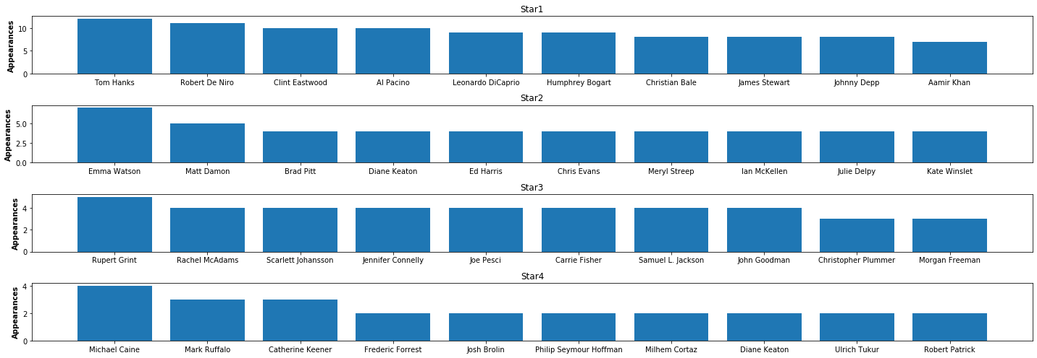
Stars with most occurrences in movies

Slide 19
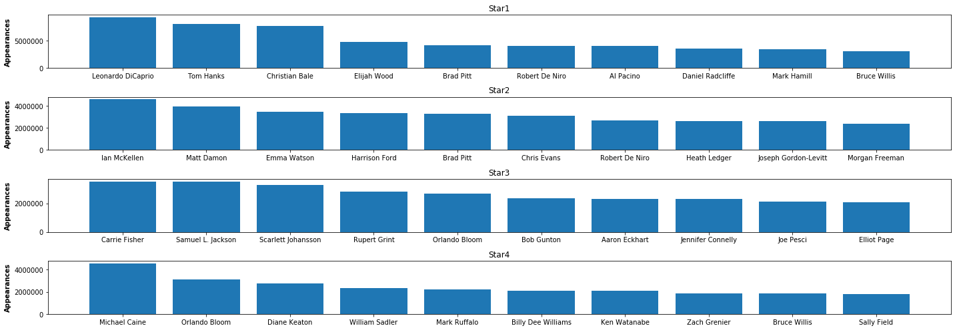
Appearances Of Stars in Top voted movies

Slide 20
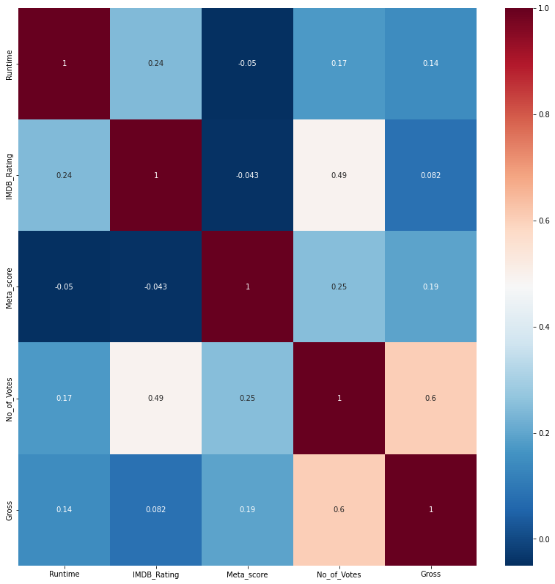

Slide 21
Insights
Drama is the most loved genre.
Older films tend to have higher ratings IMDB_score and Meta_score.
Negative correlation between IMDB_rating and Meta_score.
Despite Shawshank redemption being the highly rated movie, it’s gross collection is too low.

Slide 22
Conclusion
Based on the analysis, we can conclude that there are lot of parameters to consider while measuring success of a movie. For some movies, total vote count becomes important while for some gross collection is an important parameter. Same is the case with the presence of different actors and directors in a movie. Presence of certain actors and directors dont decide fate of the movie.Shawshank Redemption: Movie with highest votes does not have mostly occurred director or actor.

Slide 23
THANK YOU!

